Slide 1
Introduction:
- Efficient water resource utilization is crucial in modern agriculture. - Suboptimal watering practices can lead to water waste, environmental issues, and reduced crop yields. - Our project addresses this challenge through the design and development of a smart plant watering system.

Slide 2
System Overview:
- Components: Arduino Uno microcontroller, soil moisture sensor, water pump, relay channel, transistor, and LEDs. - Functionality: Continuous monitoring of soil moisture levels, activation of water pump when moisture falls below threshold, LED indicator for system status.

Slide 3
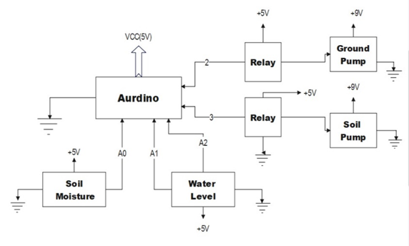
Diagram:

Slide 4
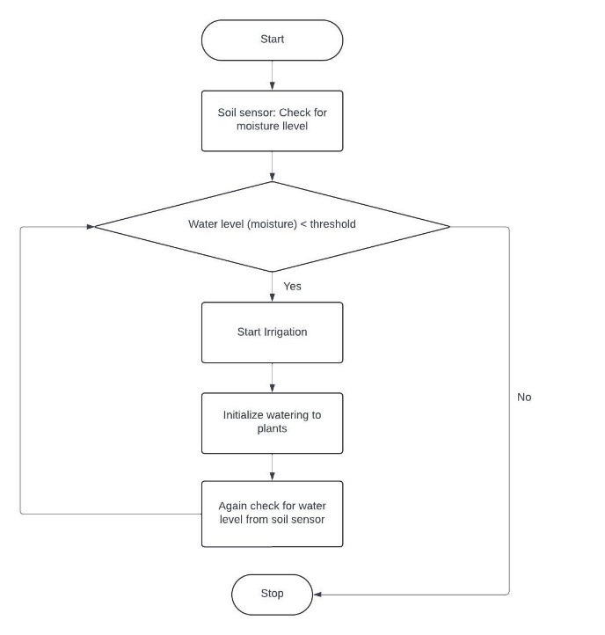
Flowchart:

Slide 5
Key Features:
- Automation: Automated watering process based on soil moisture levels. - Precision: Delivers precise amount of water to plants, minimizing water waste. - Customization: Programmable parameters for watering schedules, moisture thresholds, and pump operation.

Slide 6
Benefits:
- Optimal hydration for plants, mitigating risks of over- or under-watering. - Customizable to accommodate diverse plant varieties or crop types. - Low-cost IoT-enabled solution suitable for small-scale gardens, greenhouses, and large-scale farming operations.

Slide 7
Future Scopes :
Precision Agriculture
AI-driven Recommendations
Connected Ecosystem Integration
Educational and Research Applications

Slide 8
Conclusion:
- Our smart watering system demonstrates the potential to enhance agricultural efficiency and promote sustainable water management practices. - Ready for deployment in various agricultural settings, contributing to improved water conservation and enhanced plant growth and productivity.

Slide 9
THANK YOU

